Slide 1
UNIT 8
THE WORLD AROUND US

Slide 2
LESSON 5
GRAMMAR

Slide 3
WARM-UP
Read the sentences and answer the questions.
1. Which sentences are better and give us enough information?
1.I was sick, I stay at home.
2.I was sick so I stay at home.
2. Why number 2 and 4 are better sentences?
3.I stayed at home, it rained.
4. I stayed at home because it rained.

Slide 4
GRAMMAR
Conjunctions ( từ nối)
Definition
“ so”
other conjunctions

Slide 5
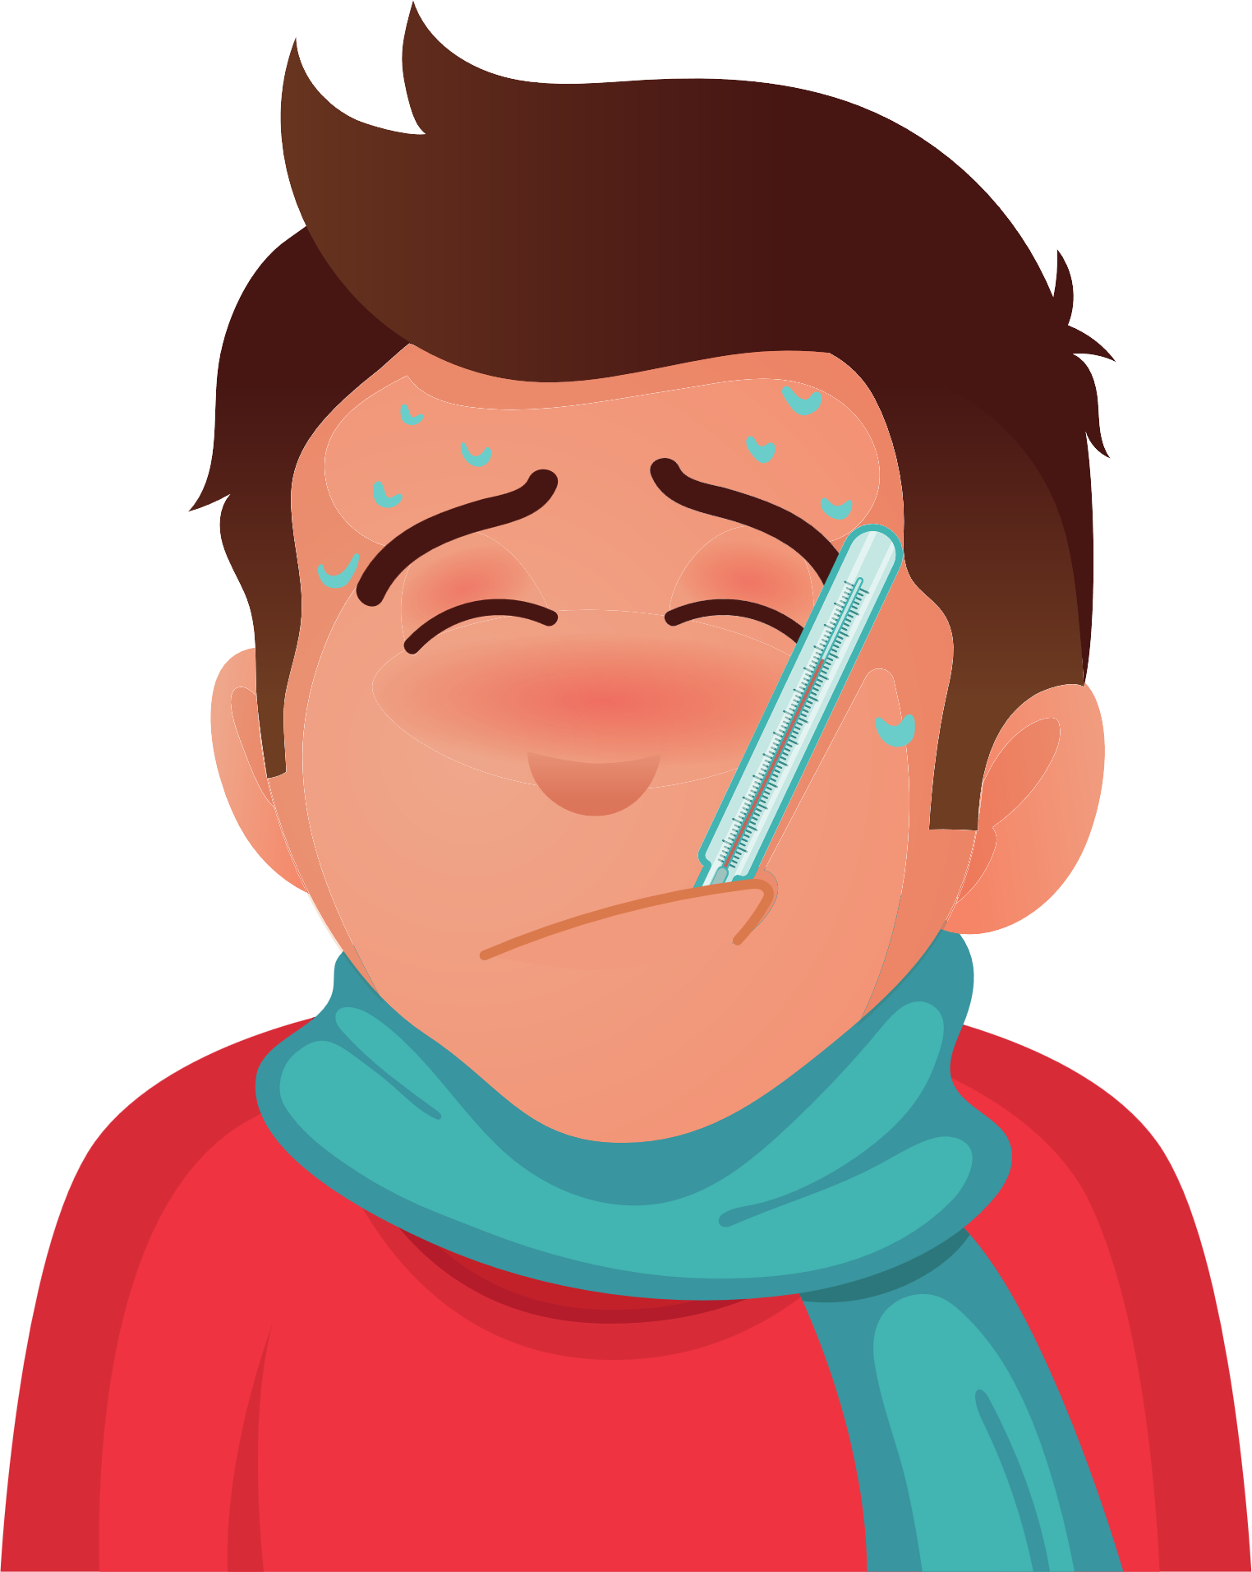
Example
Definition
- Từ nối trong tiếng Anh (còn gọi là linking words hay conjunctions), được dùng để liên kết giữa các câu, giúp cả đoạn văn chặt chẽ hơn, mạch lạc hơn.
I was sick , so I stayed at home.
So: Vì vậy
- Dùng để nói về kết quả của một sự việc nào đó.

Slide 6
a. Listen and repeat.
We use so to show a result of something.
Grammar
What do we need to bring?
I had a cold so I didn’t go to school. We are going to kayaking so you need to bring a towel.
We need to bring a tent so we can sleep
Anything else?
We need to bring bottled water so we don’t get thirsty.

Slide 7
b. Match the two halves of the sentences.
We need to bring flashlights. A. so you should bring some bottled water
We should bring jackets B. We can see at night.
They don’t have water at the campsite C. so we need to bring some boots.
We are going hiking D. so we can eat lunch.
You neen to bring some food E. so you can read at night.
You should take a book F. so we don’t get cold.

Slide 8
c. Look at the table and write Tim’s answers.
Jan: Should we bring a tent?
Tim: 1. Yes, we should so we have somewhere to sleep.
Jan: Should we bring bottled water?
Tim: 2. ______________________________
Jan : should we bring jackets?
Tim: 3. ______________________________
Jan: Should we bring comic books?
Tim: 4. _________________________________
Jan: Should we bring food?
Tim : 5._________________________________
Jan: Should we bring money?
Tim. 6. _________________________________
ITEMS TO BRING | REASONS
a tent | have somewhere to sleep
bottled water | don’t get thirsty
jackets | don’t get cold
comic books | have something to read
food | don’t get hungry
money | can buy presents
Yes, we should ,so we don’t get thirsty.
Yes, we should ,so we don’t get cold.
Yes, we should ,so we have something to read.
Yes, we should ,so we don’t get hungry
Yes, we should ,so we can buy presents.

Slide 9
d. Now, practice the conversation with your partner.

Slide 10
OTHERS CONJUNCTIONS
I eat a lot of vegetables and I also do exercise everyday.
and : và
but: nhưng
He is fat but he doesn’t like do exercise.
because : bởi vì
or : hoặc
I stayed at home because it rained.
You study hard or you fail the exam.

Slide 11
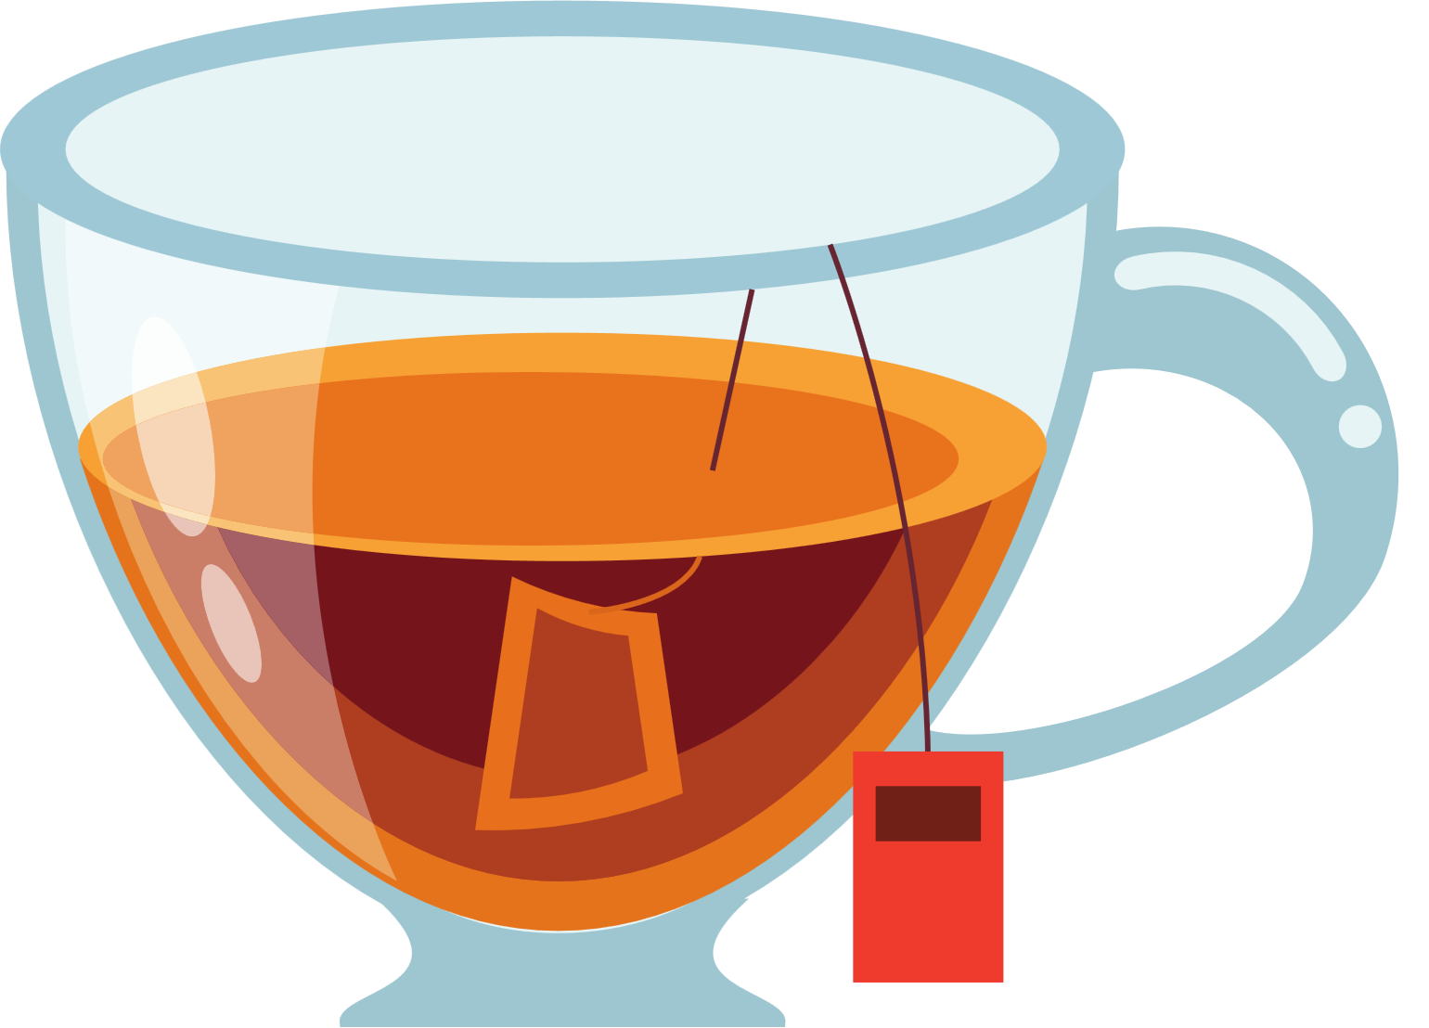
1. Choose the correct answer
so
but
1. Sarah likes tea................she hates coffee.
but
or
because

Slide 12
Choose the correct answer
so
2. Is it Monday.........Tuesday today?
or
because
or
and

Slide 13
Choose the correct answer
because
3. He didn’t go to school ......he was sick yesterday.
so
but
and

Slide 14
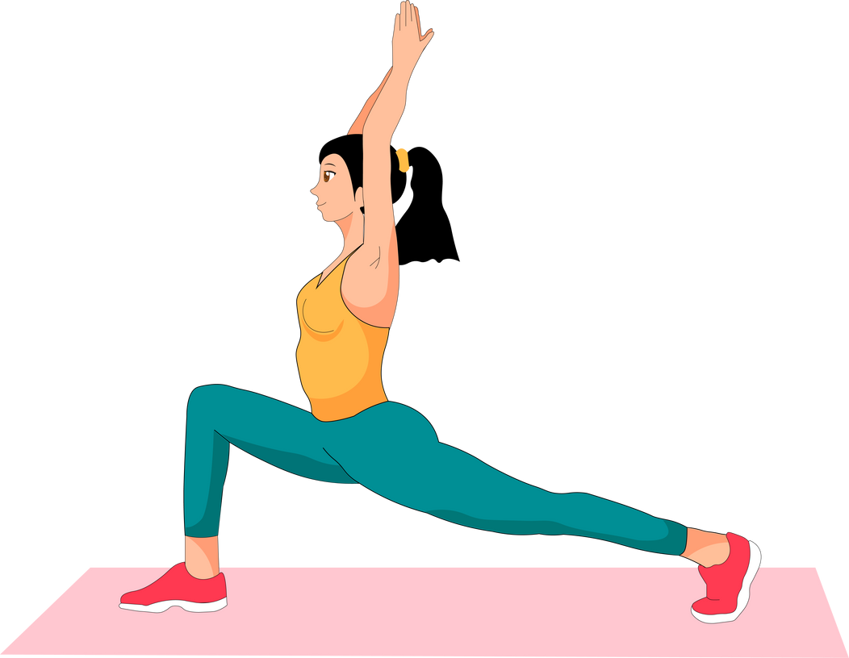
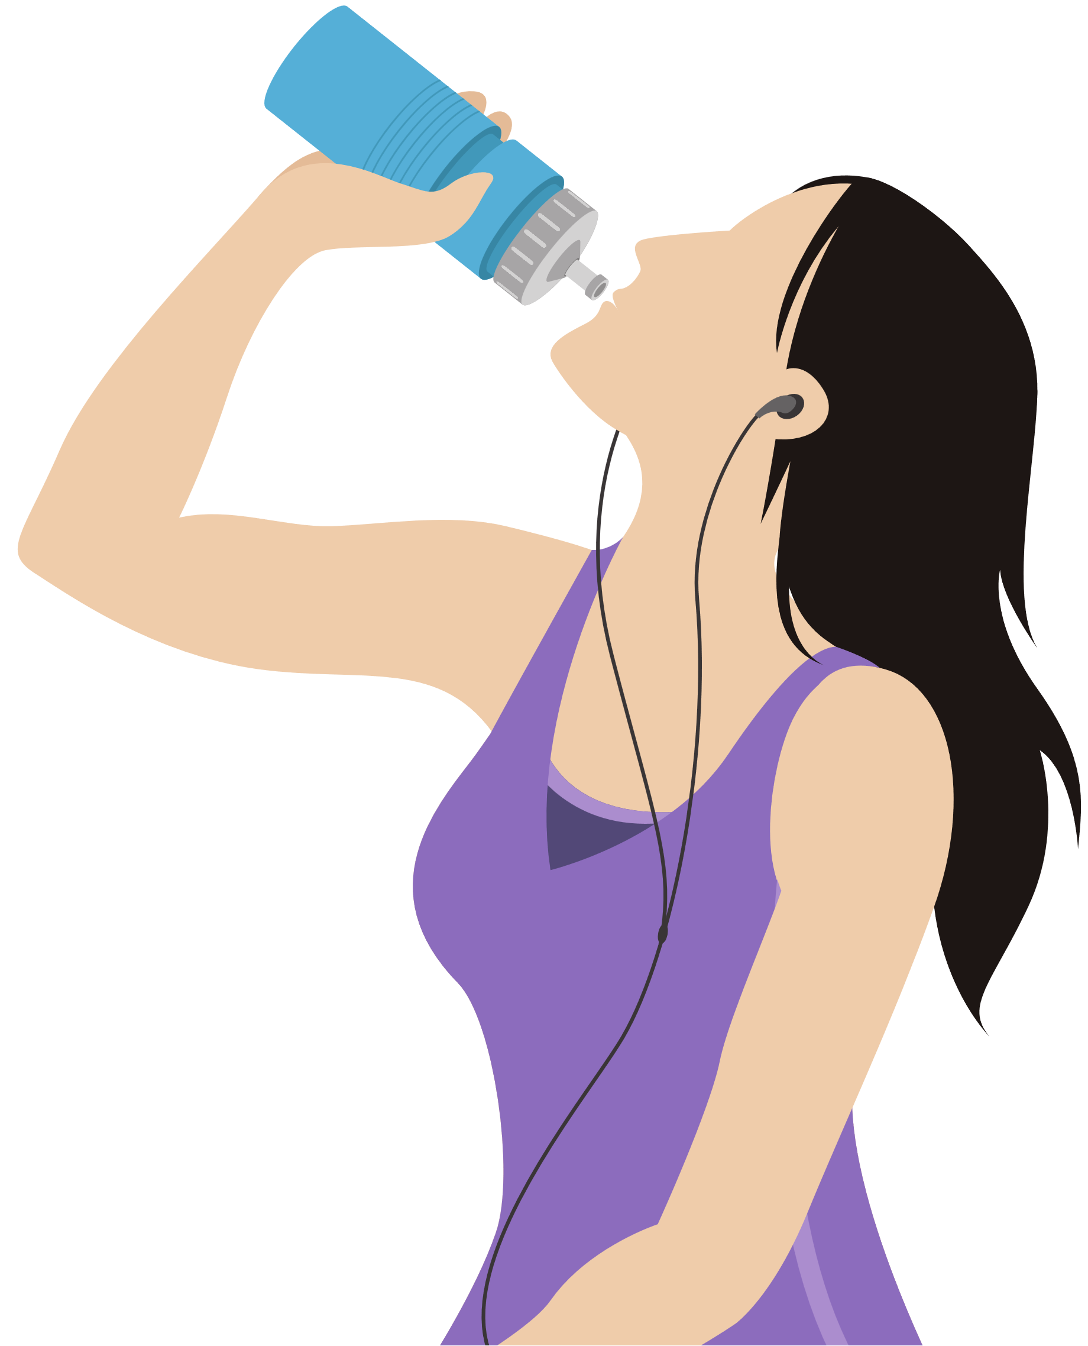
Choose the correct answer
because
4. I drink more water .......I do exercise to have a good health.
and
but
so
and

Slide 15
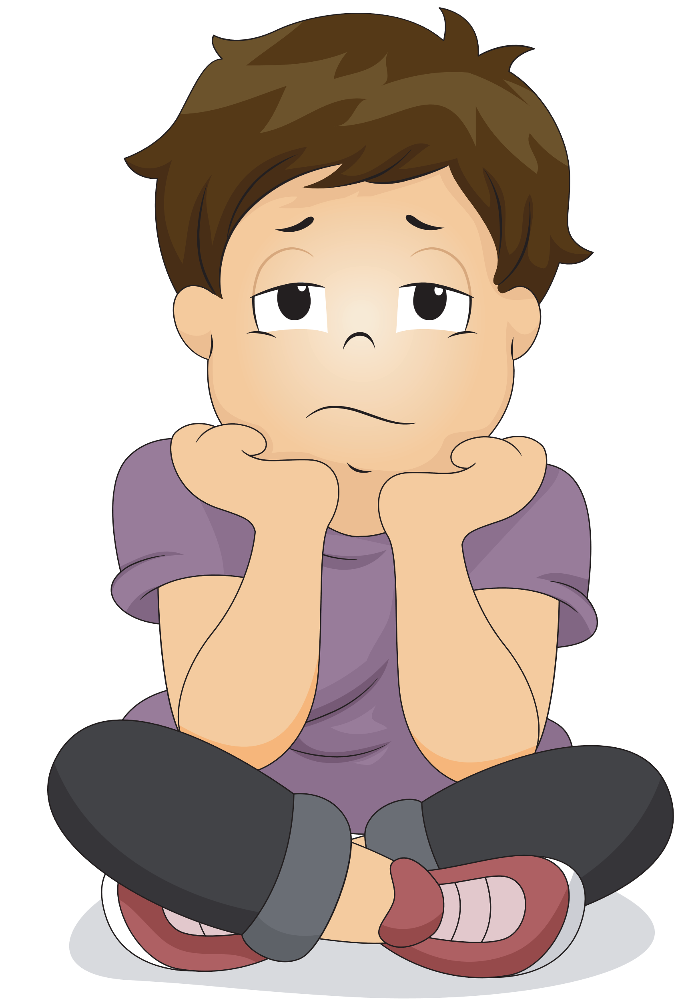
Choose the correct answer
so
5. The film was boring.......I turned of the TV.
so
but
because
and

Slide 16
Choose the correct answer
because
6. It is raining .......we have to bring an umbrella.
so
so
and
but

Slide 17
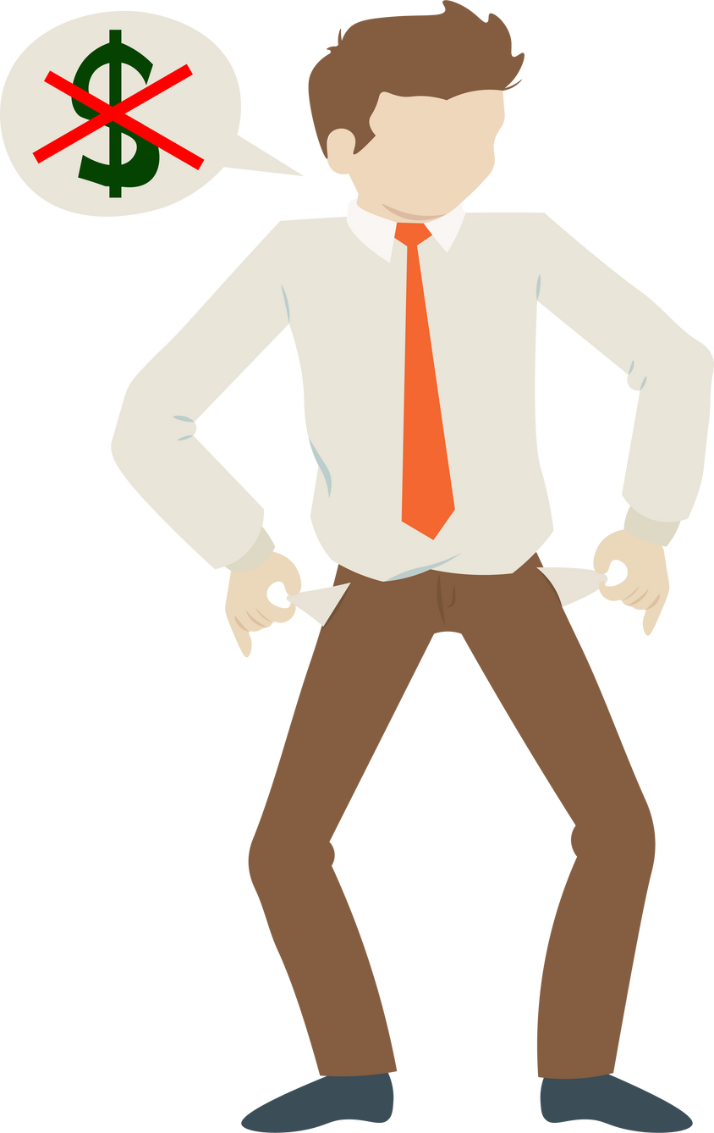
Choose the correct answer
or
7. I can’t buy a new house.......I don’t have money.
so
because
but

Slide 18
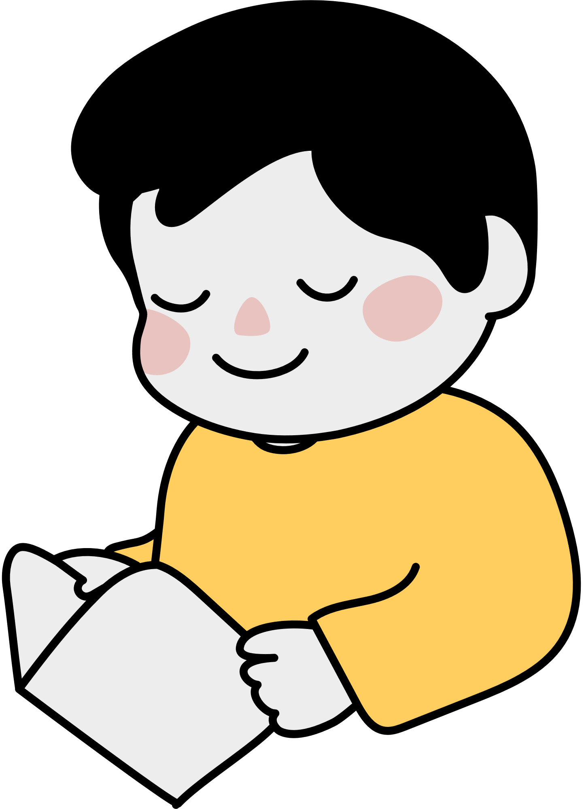
Choose the correct answer
so
8. You have to study hard......you fail the exam.
but
because
or

Slide 19
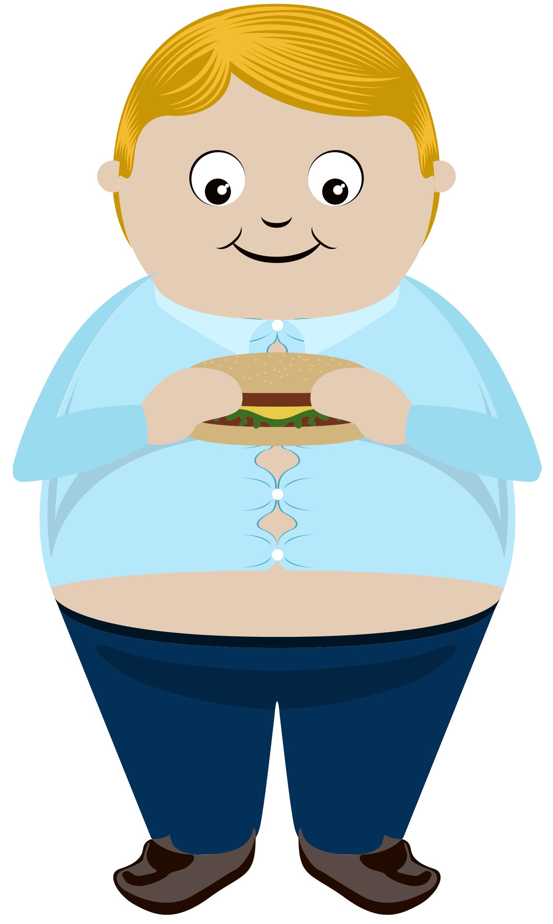
Choose the correct answer
so
9. He is fat ......he eats a lot.
and
but
or

Slide 20
Choose the correct answer
because
10. Which pen do you like? the black one......the blue one?
or
so
but

Slide 21
WARP-UP

Slide 22
Unit 8
The world around us
Lesson 5: GRAMMAR
Conjunctions : Liên từ/từ nối
Từ nối trong tiếng Anh (còn gọi là linking words hay conjunctions), được dùng để liên kết giữa các câu, giúp cả đoạn văn chặt chẽ hơn, mạch lạc hơn.
Common conjunctions : (Những từ nối thường gặp)
So: Vì vậy
- Others : and : và, but: nhưng , or : hoặc là , because : bởi vì.

Slide 23
HOMEWORK
Learn the use of conjunction "so".
- Do exercises: Grammar a, b on page 47 in workbook.
- Prepare for the next lesson: UNIT 8 - Lesson 2 – Pronunciation - Speaking on page 67.
- Ask them to think of what they need to prepare for a camping trip.

